Slide 1







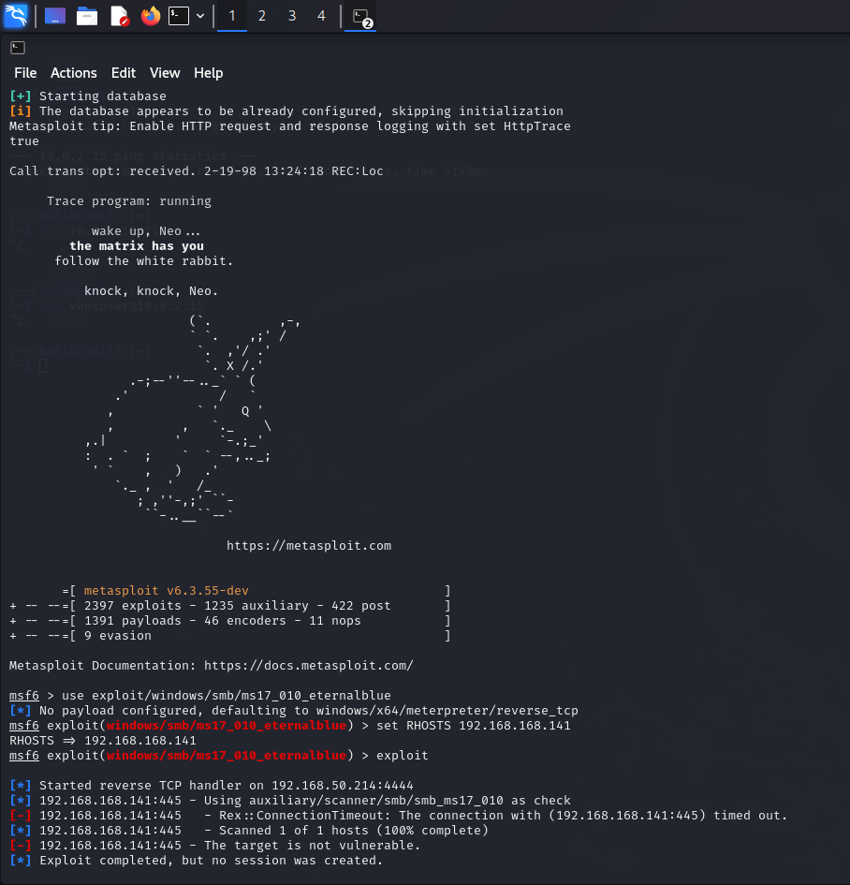

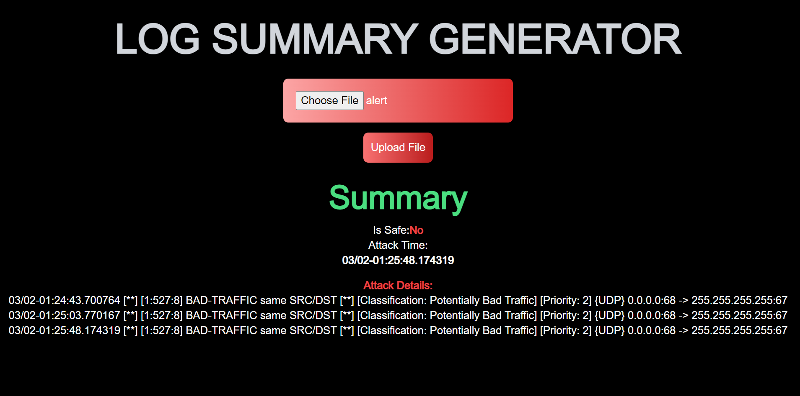


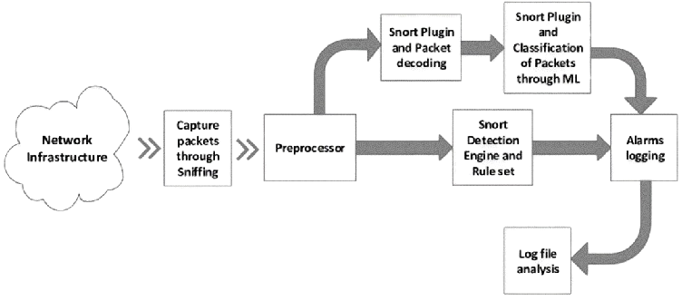

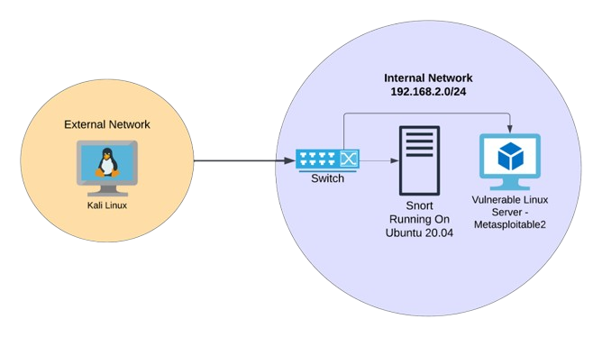
NETWORK INTRUSION DETECTION SYSTEM
Chandan B, Vijayendra Nayak, Darshith Pandith , Balamurali M and Guide: Mrs. Shwetha S Shetty
Department of Information Science & Engineering
Sahyadri College of Engineering & Management Mangaluru
Abstract
Results and Discussion
Discover the power of Network-Based Intrusion Detection Systems (NIDS) in safeguarding modern networks. NIDS serves as a vigilant sentinel, continuously monitoring traffic for anomalies and threats. Employing real-time analysis and advanced detection techniques, NIDS ensures rapid identification and mitigation of unauthorized access and breaches. This abstract emphasizes NIDS' pivotal role in fortifying network security and enhancing cyber resilience in today's digital environment.
Introduction
In the realm of cybersecurity, Network-Based Intrusion Detection Systems (NIDS) serve as essential guardians, protecting modern networks from digital threats. This exhibition illuminates the vital role of NIDS in securing digital environments. NIDS operates as a vigilant sentinel, continuously monitoring network traffic to swiftly detect and neutralize potential intrusions in real time. Through advanced techniques and constant surveillance, NIDS ensures the integrity and safety of networks, defending against unauthorized access attempts, data breaches, and other malicious activities
Fig (5) Intrusion Detection System
Fig (1) Introduction to NIDS
Methodology
Fig (6 & 7) Malware exploitation using Metasploit framework in Kali Linux
Fig (2) The network activity and potential attack attempt.
Fig (8) Web Interface to check log file
Conclusion
This study sheds light on key security risks faced by systems, including information interception, tampering, denial of services, resource stealing, and information faking. By evaluating Intrusion Detection Systems (IDS), we've found they are effective in mitigating these risks, particularly in maintaining information confidentiality, integrity, and availability.
We've explored the historical development, classification, and categorization of IDS, along with various intrusion detection methods, providing a comprehensive understanding. Despite limitations, advancements in IDS technology, such as the shift towards Intrusion Prevention Systems, demonstrate their adaptability.
In conclusion, IDS plays a crucial role in ensuring security and is poised to drive future trends in IDS technology.
Fig (3) Block diagram of how the Intrusion Detection is performed.
The process of sending and receiving packets through a network infrastructure. The packets are sent to the network infrastructure, where they are processed by the network infrastructure. The packets are then forwarded to their destination. The text in the image mentions Snort, a network intrusion detection system (NIDS). NIDS is a security software application that monitors a computer network for
Reference
[1] Niva Das and Tanmoy Sarkar. Survey on host and network based intrusion detection system. International Journal of Advanced Networking and Applications, 6(2):2266, 2014.
[2] Kopelo Letou, Dhruwajita Devi, and Y Jayanta Singh. Host-based intrusion detec tion and prevention system (hidps). International Journal of Computer Applications, 69(26):28–33, 2013.
[3] Hung-Jen Liao, Chun-Hung Richard Lin, Ying-Chih Lin, and Kuang-Yuan Tung. In trusion detection system: A comprehensive review. Journal of Network and Computer Applications, 36(1):16–24, 2013.
Fig (4) Lab Environment

